Slide 1

CSE3251
Computer Networks
Dr. Asif Zaman
Professor, CSE, RU

Slide 2
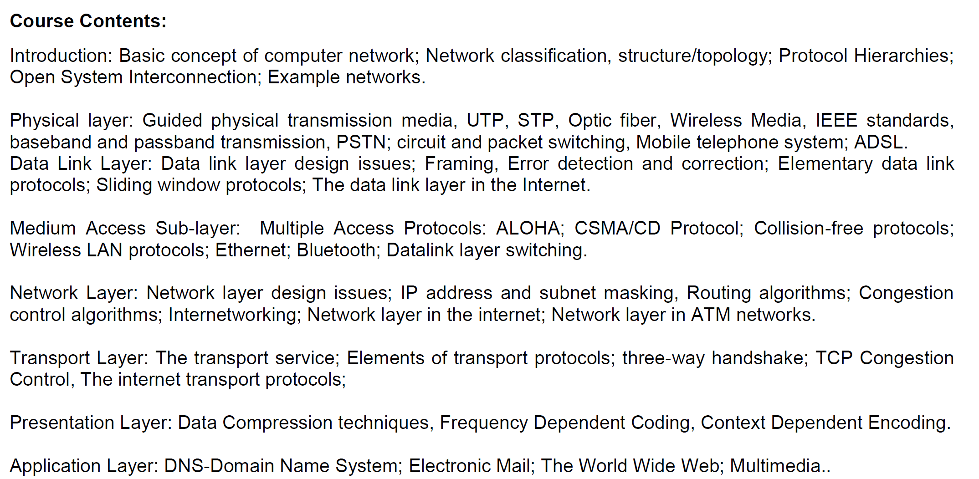

Slide 3
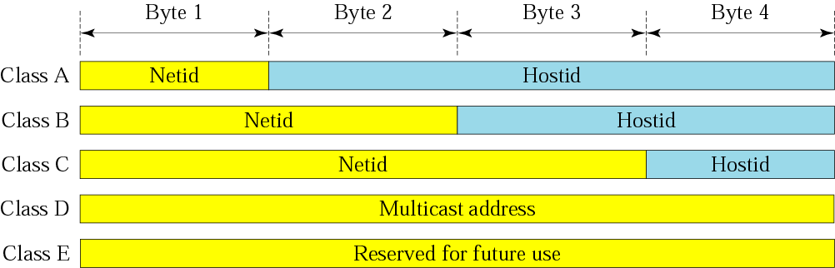
Netid and hostid

Slide 4
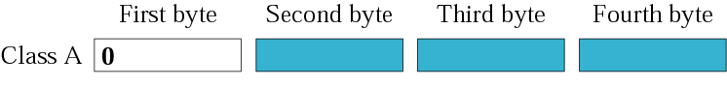
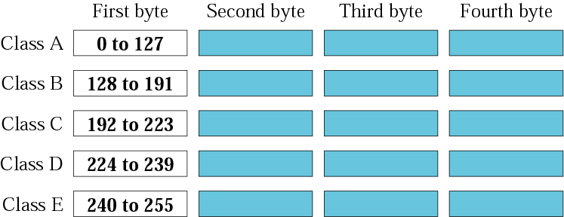
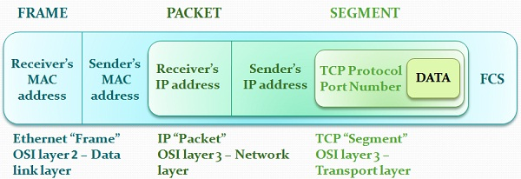
73.X.X.X
Router

Slide 5
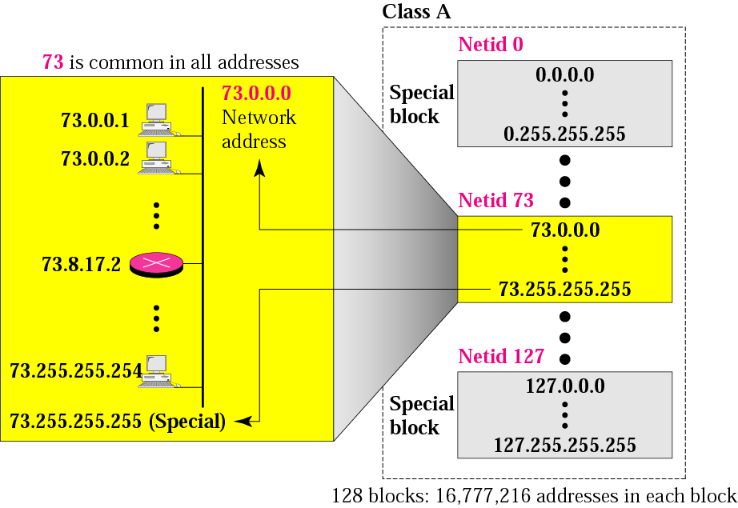
Blocks in class A

Slide 6

Millions of class A addresses are wasted.

Slide 7
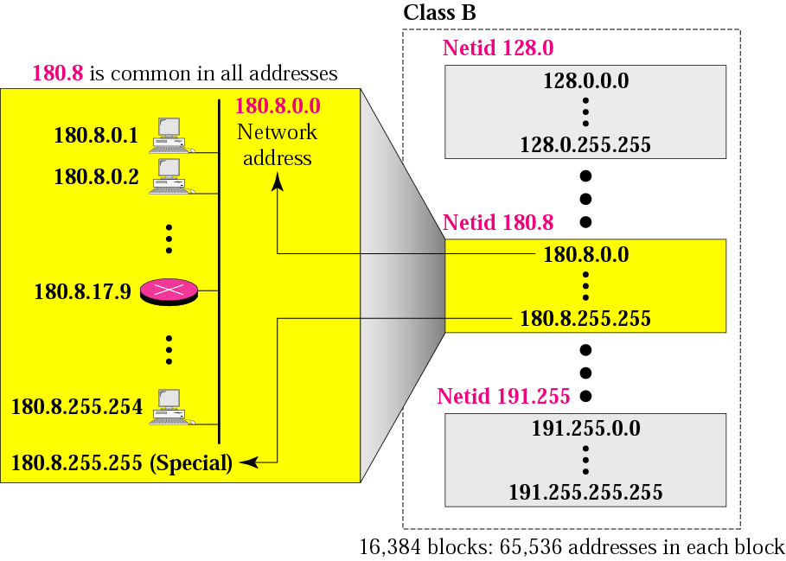
Blocks in class B

Slide 8
Many class B addresses are wasted.

Slide 9
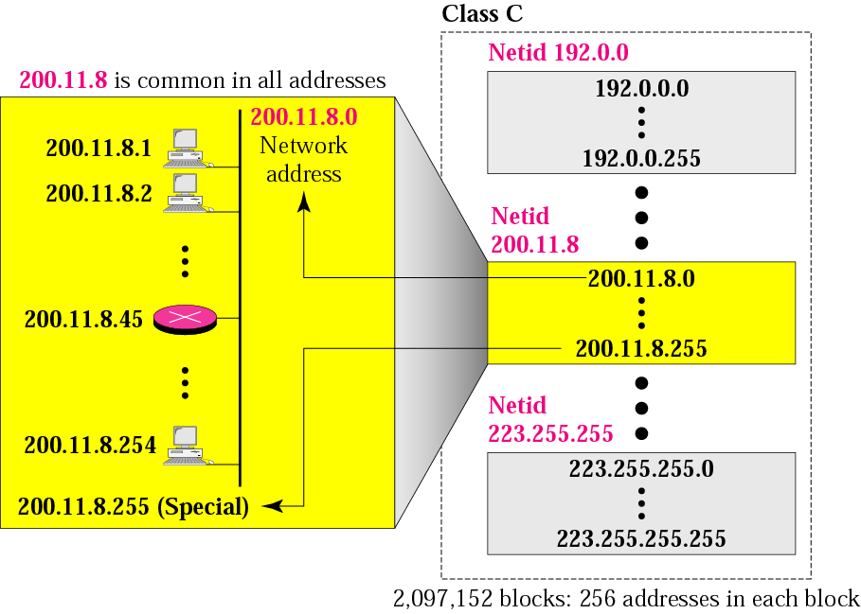
Blocks in class C

Slide 10
The number of addresses in a class C block is smaller than the needs of most organizations.

Slide 11
Class D addresses are used for multicasting; there is only one block in this class.

Slide 12
Class E addresses are reserved for special purposes; most of the block is wasted.

Slide 13
Network Addresses
The network address is the first address.
The network address defines the network to the rest of the Internet.
Given the network address, we can find the class of the address, the block, and the range of the addresses in the block

Slide 14
In classful addressing, the network address (the first address in the block) is the one that is assigned to the organization.

Slide 15
Mask
A mask is a 32-bit binary number.
The mask is ANDeD with IP address to get
The block address (Network address)
Mask And IP address = Block Address

Slide 16
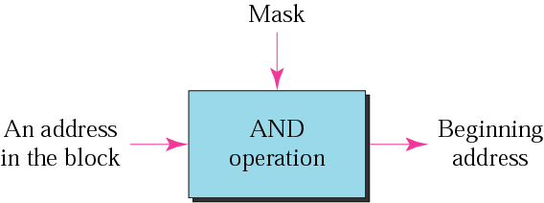
Masking concept

Slide 17
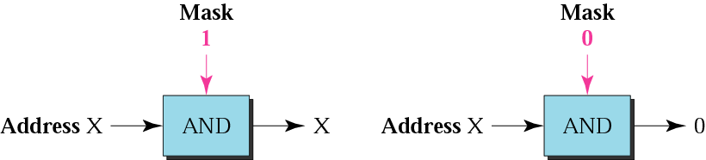
AND operation

Slide 18
The network address is the beginning address of each block. It can be found by applying the default mask to any of the addresses in the block (including itself). It retains the netid of the block and sets the hostid to zero.

Slide 19
Default Mask
Class A default mask is 255.0.0.0
Class B default mask is 255.255.0.0
Class C Default mask 255.255.255.0

Slide 20
Subnetting and Classless Addressing

Slide 21
SUBNETTING

Slide 22
Note
Subnetting is done by borrowing bits from the host part and add them the network part

Slide 23
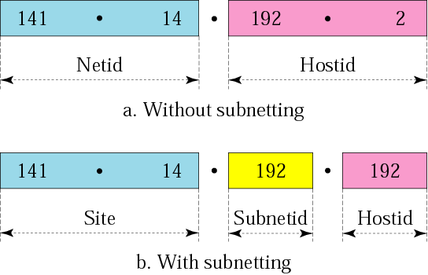
Addresses in a network with and without subnetting

Slide 24
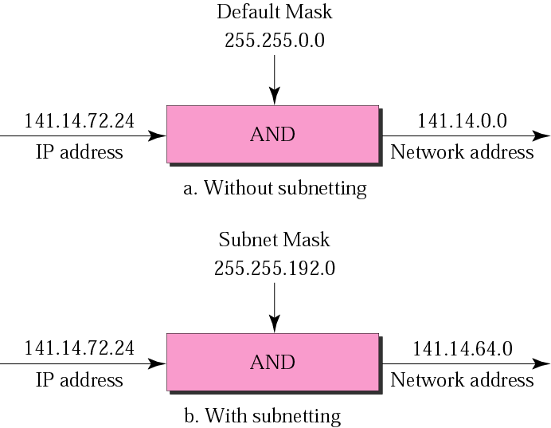
Default mask and subnet mask
72 =01001000
=11000000
01000000=64

Slide 25
Finding the Subnet Address
Given an IP address, we can find the subnet address the same way we found the network address. We apply the mask to the address. We can do this in two ways: straight or short-cut.

Slide 26
Straight Method
In the straight method, we use binary notation for both the address and the mask and then apply the AND operation to find the subnet address.

Slide 27
Example
What is the subnetwork address if the destination address is 200.45.34.56 and the subnet mask is 255.255.240.0?

Slide 28
Solution
11001000 00101101 00100010 00111000
11111111 11111111 11110000 00000000
11001000 00101101 00100000 00000000
The subnetwork address is 200.45.32.0.

Slide 29
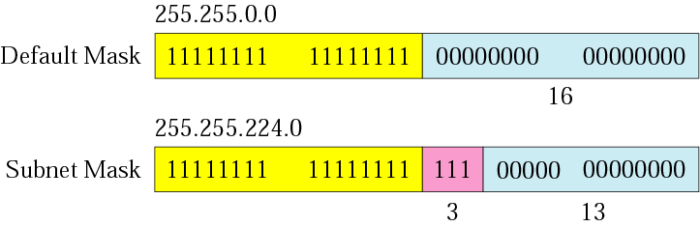
Comparison of a default mask and
a subnet mask

Slide 30
The number of subnets must be a power of 2.

Slide 31
Example
A company is granted the site address 201.70.64.0 (class C). The company needs six subnets. Design the subnets.
Solution
The number of 1s in the default mask is 24 (class C).

Slide 32
201.70.64.0/24
255.255.255.0
201.70. 01000000.0000 0000
My Company
Network
R1
R
R2

Slide 33
201.70. 01000000.0000 0000
My Company
Network
R

Slide 34
Solution (Continued)
The company needs six subnets.
This number 6 is not a power of 2.
The next number that is a power of 2 is 8 (2³).
We need 3 more 1s in the subnet mask.
The total number of 1s in the subnet mask is 27 (24 + 3).
The total number of 0s is 5 (32 - 27). The mask is

Slide 35
Solution (Continued)
11111111 11111111 11111111 11100000
or
255.255.255.224
The number of subnets is 8.
The number of addresses in each subnet is 2⁵ (5 is the number of 0s) or 32.

Slide 36
201.70. 64.000 00000
201.70. 64.001 00000
201.70. 64.010 00000
201.70. 64.111 00000
: 201.70.64.0
: 201.70.64.32
: 201.70.64.64
: 201.70.64.224
My Company
Network
R

Slide 37
201.70. 64.000 00000
201.70. 64.000 00001
201.70. 64.000 00010
201.70. 64.000 00011
201.70. 64.000 11111
: 201.70.64.1
: 201.70.64.2
: 201.70.64.3
: 201.70.64.31

Slide 38
201.70. 64.001 00000
201.70. 64.001 00001
201.70. 64.001 00010
201.70. 64.001 00011
201.70. 64.001 11111
: 201.70.64.33
: 201.70.64.34
: 201.70.64.35
: 201.70.64.63

Slide 39
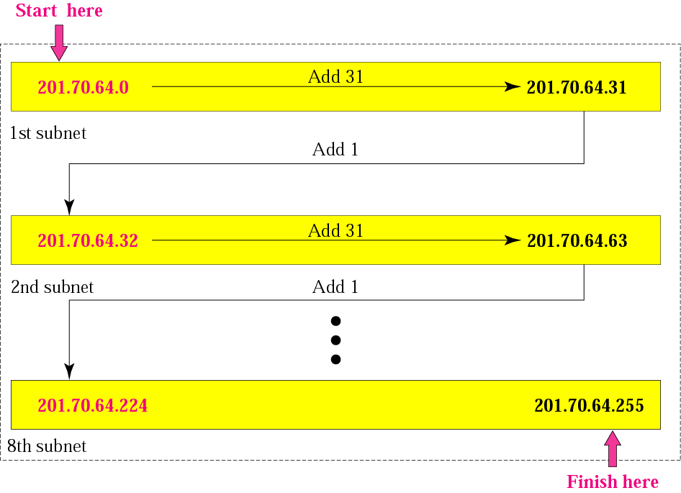
Example

Slide 40
Example
A company is granted the site address 181.56.0.0 (class B). The company needs 1000 subnets. Design the subnets.
Solution
The number of 1s in the default mask is 16 (class B).

Slide 41
Solution (Continued)
The company needs 1000 subnets. This number is not a power of 2. The next number that is a power of 2 is 1024 (2¹⁰). We need 10 more 1s in the subnet mask.
The total number of 1s in the subnet mask is 26 (16 + 10).
The total number of 0s is 6 (32 − 26).

Slide 42
The mask is
11111111 11111111 11111111 11000000
or
255.255.255.192.
The number of subnets is 1024.
The number of addresses in each subnet is 2⁶ (6 is the number of 0s) or 64.
See next slide

Slide 43
